Slide 1


Natus Vincere
Ced Intelligence
To innovate and create solutions that will shape the future of English proficiency test learning

Slide 2

Table of contents
The Purpose
Problem Statement
Innovative Solutions
About This Project
Discover Business Potential
This Project is based on my research. It provides a comprehensive benchmark of the impact of IBM Watsonx Assistant on English proficiency test learning.
Flowchart of actions

Slide 3

The
purpose
I committed to empowering foreigners’ student to have or improve the English proficiency test skills. By leveraging technology, I aim to revolutionize English proficiency test learning, shaping a future of English proficiency test learning that is interactive, effective, and available worldwide.

Slide 4



PROBLEM STATEMENT
Expensive English proficiency test courses
Limited Personalized Attention
Reduced Interactive English proficiency test Learning

Slide 5

Solution
SELF LEARNING
I develop effective and interactive self leaning solution to help student get more knowledge to pass English proficiency test.

Slide 6

Business Potential
English proficiency test- takers worldwide
High demand English proficiency learning tools
A Growing market for AI

Slide 7
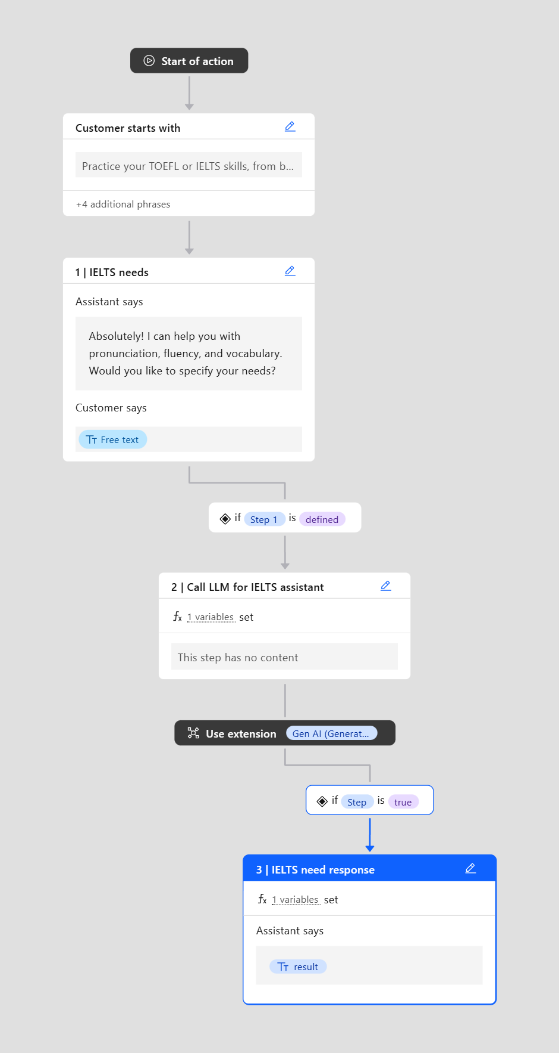
Flowchart of Actions

Slide 8
THANK YOU
for your time and attention
Present by Natus Vincere
12 Anywhere Street., Any City

